Slide 1



Plant_Visualization
View in Power BI
Last data refresh:
12/30/2024 12:17:43 PM UTC
Downloaded at:
12/30/2024 4:22:03 PM UTC

Slide 2
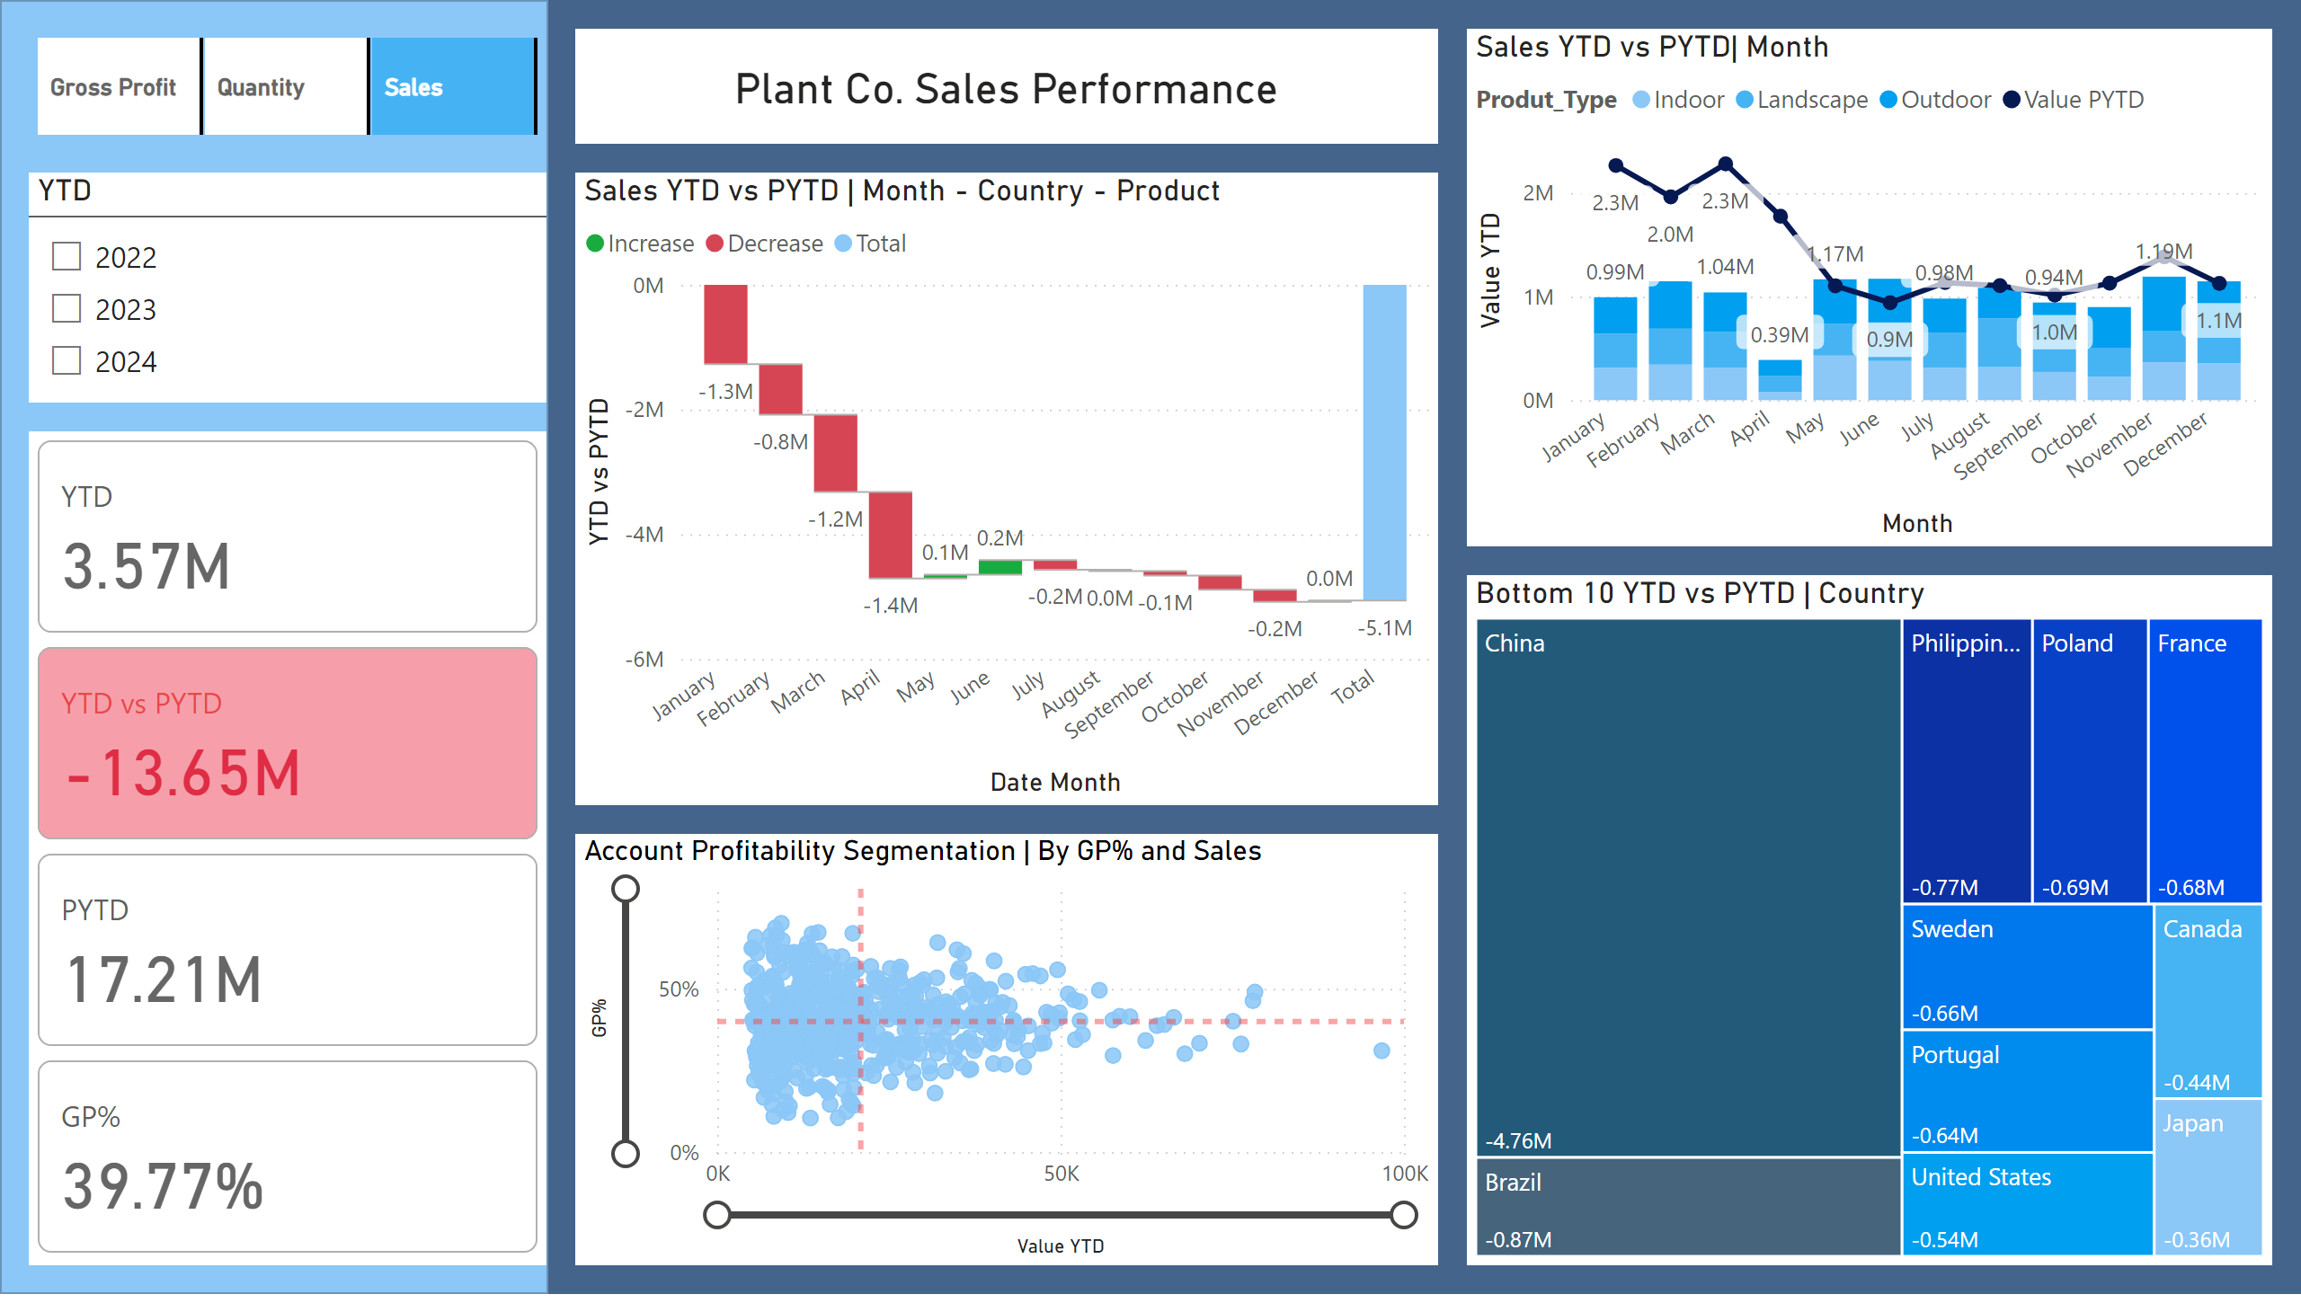
Page 1
Notes:
cardVisual
No alt text provided
advancedSlicerVisual
No alt text provided
YTD
No alt text provided
Bottom 10 YTD vs PYTD | Country
No alt text provided
Sales YTD vs PYTD | Month - Country - Product
No alt text provided
Sales YTD vs PYTD| Month
No alt text provided
Account Profitability Segmentation | By GP% and Sales
No alt text provided
card
No alt text provided
shape
No alt text provided

